Slide 1
MAR 653
Group Three: Micaela Geiman, Jacob Dineen, Ruben Suzara, Sam Harvey, and Fiona Erickson

Slide 2
Movie Dataset
We’ll use an open source data set of 5000 films (including variables such as budget, gross, ratings, titles, etc) to evaluate what learnings a movie studio could take away from this data and how it could help them make business decision moving forward.
Tools needed: Python, Weka, R, Excel, XLStat
Machine Learning Techniques: Logit Models, Neural Nets, Natural Language Processing/Text Mining, Clustering, Association Rules/Recommendation Engines
Resources: StackOverflow, R/Py documentation, Course Materials
Data found here. A popular data cleaning script was used to ‘normalize’ the dataset, reverting it to its pre-scraped format - The script focused on pulling features from within data dictionaries (Json).

Slide 3
Objective
Our main objective is to understand the relationship between features in our dataset against box office performance. If we could construct a model to predict box office performance based on descriptions of certain movies, we could better understand what drives box office revenues. We will do so by using logistic regression to predict profitability (cutpoint at the median of profit - 2mm USD) and also by using a linear model to try and predict the continuous output. Approaching this from the view that we are a movie studio, we could use certain features to predict box office performance before spending a dime on production.
Another important objective is that of understanding how a prospective movie relates to historical movies. We will use a nearest-neighbors based approach to understand, based on key features, how similar a movie is to movies that were released in the past. Understanding the historical data will allow us to understand how similar movies performed at the box office, and also to look back at how those movies performed with certain audiences and better plan our marketing scheme.
Additionally, we will look at visualizations and correlation matrices to better understand who and what drives box office performance.

Slide 4
Plan
Research Plan:
Each member of the group will be working on a separate subproject which will be consolidated at the end of the term and presented by each member. Subprojects will contain elements of machine learning (descriptive/predictive/prescriptive analytics), statistical analysis, marketing recommendations and adhoc visual analysis pertaining to each subproject goal. Marketing recommendations/solutions will stem from said analysis in a variety of different forms. Some potential ideas:
Content Based Recommendation Engine based on plot keywords, actors, directors, popularity/voting score. Will use popular python NLP libraries for stemming/tokenization of text. Likely to utilize distance based algorithm (nearest neighbors) for matching.
Analysis to see what factors are significant in predicting profitability or box office gross. Perform logit to emphasize feature importance in the model. Binning popularity into two classes and doing a straightforward class problem w/ logits/random forests/neural nets. Potentially doing logistic regression for isprofitable/isnotprofitable
Create visualizations on movies released by year, trends in popularity across genre and time. Making different charts and graphs to showcase our data.
Cluster analysis segmented movies into different buckets.
Correlation analysis to understand which features share relationships, and exposing multicollinearity - Feature engineering on regressors to eliminate multicollinearity.
Standard time series analysis to understand and visualize the market over time.

Slide 5
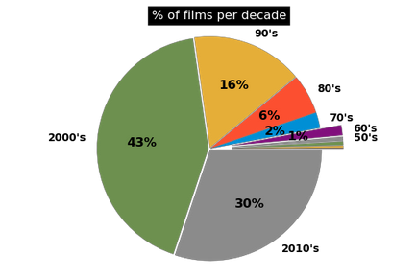
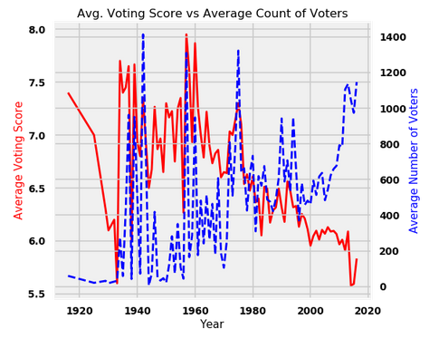
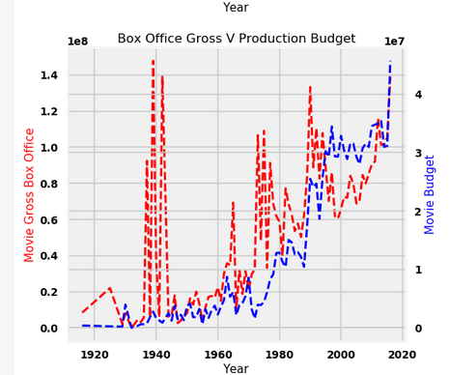
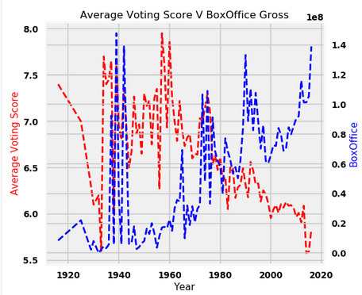
Visualization - Descriptive
Before digging too deep into statistical methodology, it is beneficial for us to analyze and visualize some basic descriptive measurements of our data, and graphical portray information. From the above charts we can derive:
There isn’t a direct linear trend between the year of a movie release and the count of votes a movie receives. Nonstationarity in regard to fluctuations. Average Voting Score, however, has consistently declined in a near linear fashion over the past 100 years’ movie releases.
Average box office gross and movie budgets appear to move in a direct relationship. The bigger the movie, the larger the expected return.
Average voting score moves downward as box office gross goes up. This more more common sensical than anything else. Large tentpole movies, while commercially lauded, are not typically critically adored due to heavy reliance on CGI and marginalized character development.

Slide 6
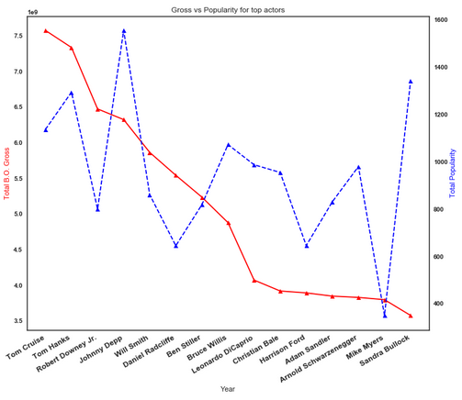
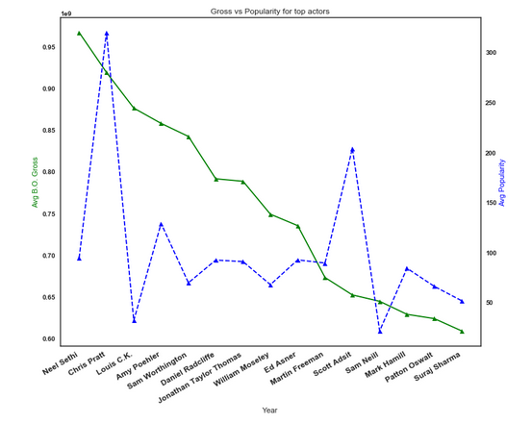
Visualization - Descriptive
Looking at the top 15 actors by total box office gross (of the 5k movies in the dataset) we can begin to see which actors might have a positive response towards their own box office performance. We can also delineate between actors who bring in money, and actors who might bring in critical acclaim as well (Johnny Depp, Sandra Bullock). This is an aggregate, however, and doesn’t account for notions of central tendency
It is likely better to look at averages to account for appearances in the top 5k movies. Above we can see the most popular movie stars, pulled from a descending list of average box office gross.The names are more obscure, but these might be, from a studio perspective, the best bang for their buck.
*This data only accounts for ‘lead’ actors in motion pictures, as characterized by their appearance in the end credits.

Slide 7
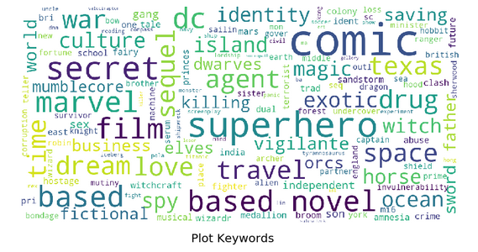
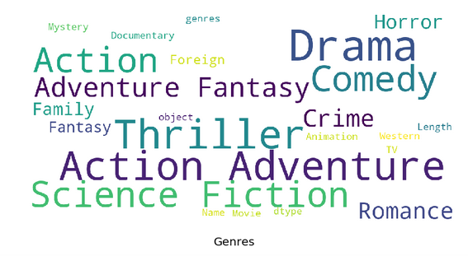
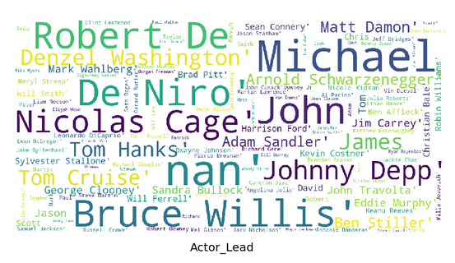
Text Analytics - WordClouds
Natural language processing, semantic processing, and term frequency vectorization are all forms of text analytics. Some may be used in a deep learning context for sequence to sequence learning (translation) or recurrent neural nets with feedback loops and long short term memory, eg. Siri/Duplex/Alexa, but some forms of text analytics offer a more simplistic representation of the data, and can be helpful with a dataset like this. Specifically, word clouds can help us to measure the density of specific words within a vector of observations. In this case, our text data is representative of the way that movies are marketed (plot keywords, synopses) and the cast relative to each observation.
Although our dataset is sampling from the population of total movies, we can begin to understand patterns about our data on a visual level, and understand the contextual distribution of our sample. *The size of a word within a wordcloud is representative of the density of the distribution of the specific word/phrase.
Perhaps the most intuitive take away from these wordclouds are seen in the distribution by Actor. Since we are looking at 5000 of the top rated movies on the TMDB, we can begin to form ideas about Lead Actors in a binomial logit or linear model aimed at predicting profitability or user ratings.

Slide 8
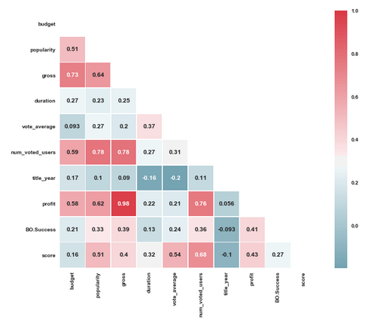
Correlation
Off the bat, we figured it might be wise to look at relationships(Noncausal) present between numerical features in our dataset. Collinearity is to be expected in some regard, due to feature engineering, but we’ll deal with that as we move towards building models.
Gross box office/Profit/And our dummy var for box office success are all highly correlated with popularity (0.5 or above).
Duration/Length of a movie has little impact on performance indicators.
Title Year doesn’t have a relationship with whether or not a movie makes money, but that could be due to the fact it’s sequential. Assuming that the gross estimates aren’t accounting for inflation, logically it would seem that there would be a natural linear trend as time passes. Conversely, average ratings have declined over the years, as new movies aren’t as highly regarded as older movies- This could coincide with diminishing returns, as there are many, many more movies being released per year and the user response can be watered down.

Slide 9
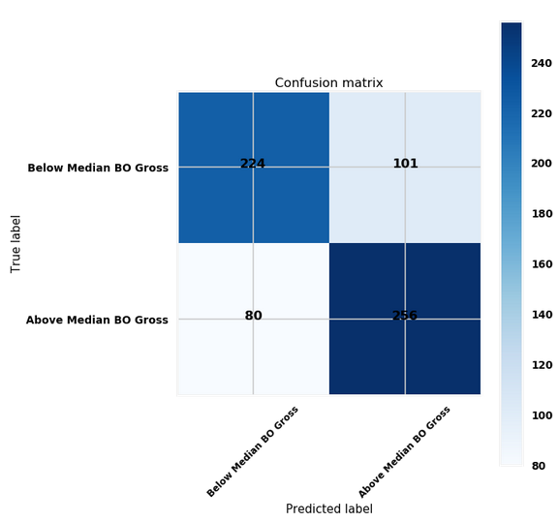
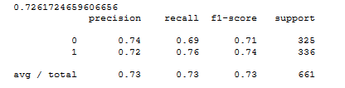
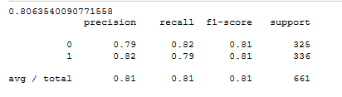
Predicting Box Office Performance Logistic
In this case, we use binarized representations of categorical data (text) in order to predict box office performance in cases where we are dealing with incomplete information. What we mean by incomplete information is that we wouldn’t generally have access to user ratings and popularity metrics before a movie is released. Using only the data that would be available to the general public at the time of release we focus mainly on: Release Year, Top billed actors (1-3), director, genres, and language.
We use the median of gross - budget as our delineator of our dependent variable, where if a profit falls above the median, then it is classified as 1, else 0. We experimented using the mean and ‘0’ as thresholds, but class imbalance was severe and we weren’t making models that were better than randomly guessing 1 every time.The median of the profit var == $2,547,569. So we will be predicting whether or not a movie makes at least $2.5mm more than its budget.
For context, the dummying of these variables resulted in a sparse matrix consisting of 8000 columns against 5000 observations. After splitting this up into a train and test set, we fit our trained model against our test set. *This has to be done with more powerful statistical software due to the size of the dataset.
Accuracy can be seen below. While 72.61% isn’t the greatest sign of a model’s ability to generalize, it is an improvement on randomly guessing whether or not a movie will be successful or not. For comparison’s sake, if we use tmdb data that we wouldn’t have at the time of a movie release - maybe we are trying to predict final box office performance after a few weeks being in theatres and garnering ratings, we could improve accuracy by 8%:
Incomplete information
Duration and Title Year were bucketed and binarized. Actors and Directors were binarized. The first noted genre was taken to classify a movies genre. Took the logarithm of budget to decrease variance.
Complete Information

Slide 10
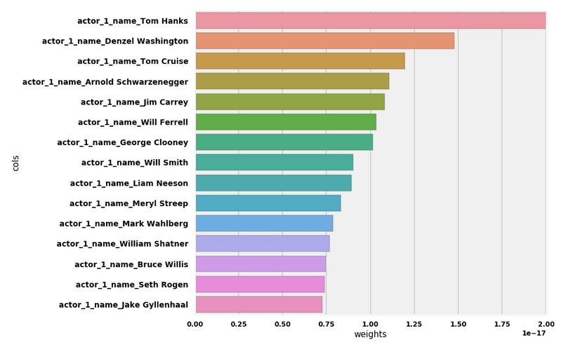
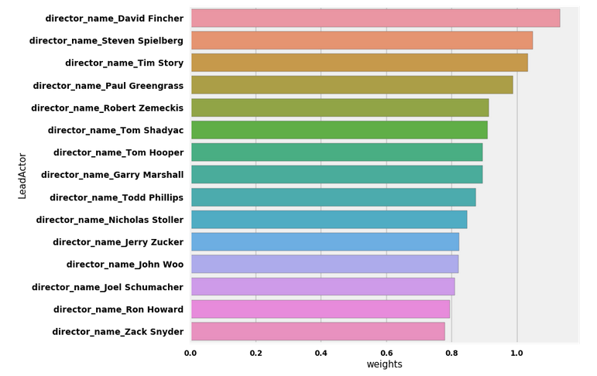
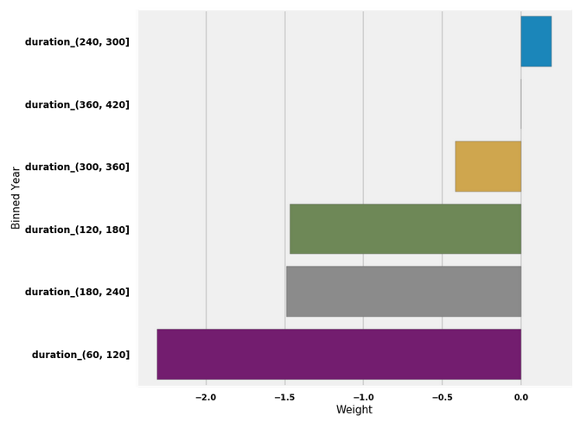
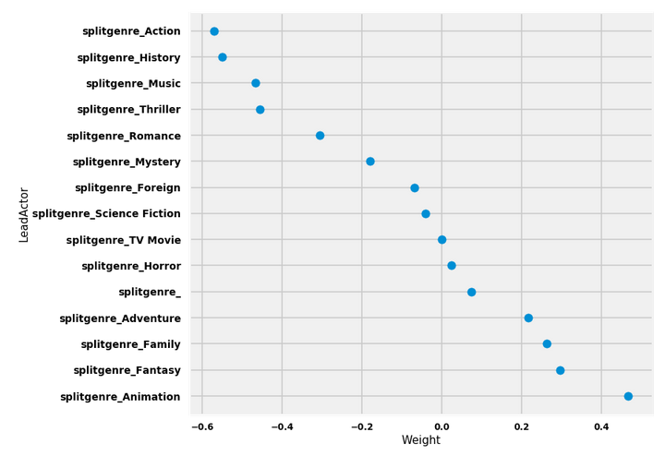
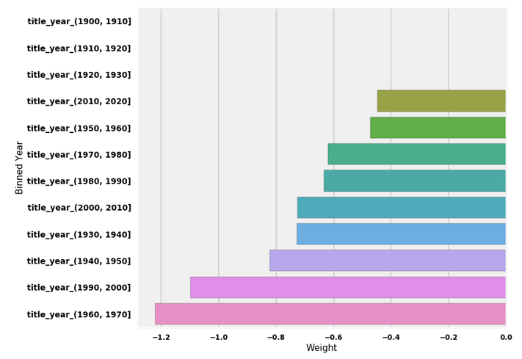
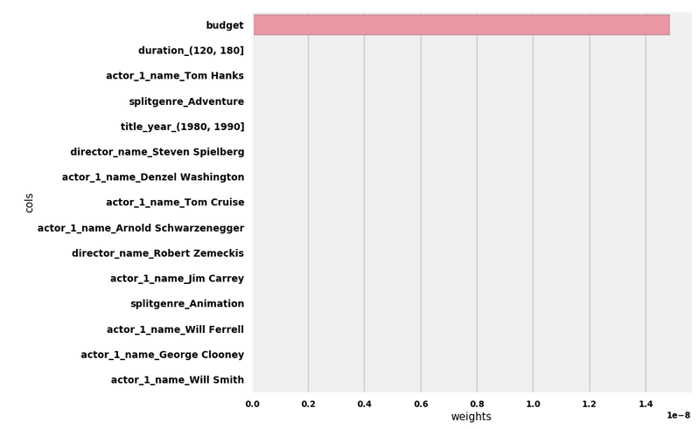
Feature Importance
With over 12k features, we’re up against the curse of dimensionality. Binning actors into tiers would be ideal, but would require in depth domain knowledge. What we can do is understand the high and low valued weights applied to features to better understand our model.
Budget is essentially moving most of the needle on our predictive capabilities before logging it. Even without logging it, the resulting value of the dotproduct between the weight and the value is responsible for most of the resulting value of the utility function.
Below we can see by feature results of which categorical representations mean the most to a model when predicting profitability. To summarize:
If a movie has any combination of the features shown below, it is very likely that the result of the logistic function (1/1+exp(-utility)) will be close to one, meaning a prediction of class == profitable.
For context on how much a movie’s budget drives it’s profitability (Using budget before taking log). <<<<

Slide 11
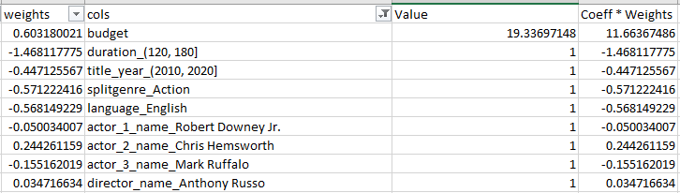

Manual Predictions
In order to truly test the predictive power of our model, we should experiment on data that is outside of the range of our domain - Also known as interpolation. This example will center around predicting binarized box office profitability for Marvel’s Infinity War based on the features we included in our fitted model.
Idk if this should be included. Kind of just shows how large of an impact budget has in predicting performance.

Slide 12
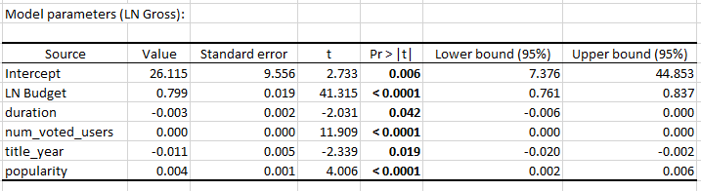
Trying Linear Regression Instead
Logistic regression is great for measuring categorical responses, but when dealing with financial data, a linear model with a continuous output variable is often preferred. Here, we will model the numeric features in our dataset against total gross. Because of our lack of data, we will use features such as average vote, number of votes, and popularity, which wouldn’t be available to us at the time of movie release, but might be during the middle to end of the theatrical run- This would be useful to predict the kind of ‘legs’ a movie will have, and where it ultimately will end up as far as total box office gross. Below is the result of our fitted model, which is trained on about 80% of the total data. We decided to take the log of gross and budget to reduce the variance in our set, and allow for more interpretable results.This resulted in an R^2 of 0.539. If we look at the below model parameters, we can see that our linear model is so geared towards budget as an input feature that the magnitude of its weight is likely to drive the entirety of the utility.

Slide 13
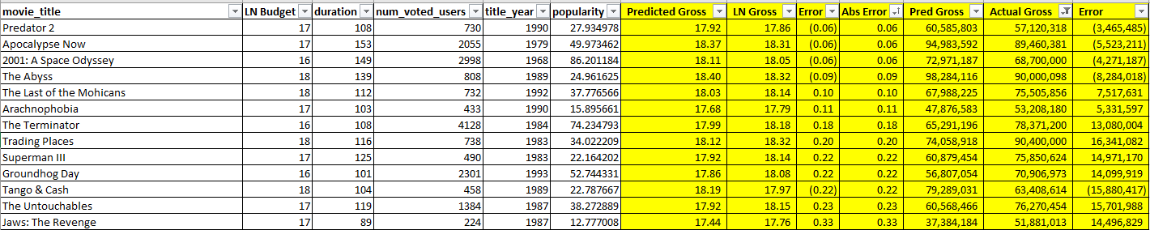
Linear Regression Results
In order to determine the predictive ability of our model, we have to use our fitted model on our test set. After we predict natural log of box office gross, we can compare it against the actual natural log of box office gross. We then compute the error between actuals and predictions. We’d normally determine a model’s ability through the result of its loss function, in this case RMSE, but that’s not necessary here.
Towards the higher and lower ends of the box office spectrum, we struggled to predict actual performance.
Our model, however, was relatively decent at predicting values within the range of 50mm-100mm in actual box office gross:
Our results suggest that the variance in the response variable is not fully accounted for by the variance in our input variables. It would be of interest to binarize all categorical variables (actors/directors/etc..) and see if that reflected a better approximation of a linear function. Also, because most of the box office actuals the model was built on are between 0-100mm US dollars, we have a hard time modeling outliers, which are represented by movies that gross far above the central tendency of the data.

Slide 14
Recommendation Engine: Overview
Jake D.
Recommendation engines implement filtering techniques based on user behavior (Collaborative Filtering) or content (Content-Based Filtering). There are also applications geared toward demographics, product utility probability, individual user’s needs, and a combination of any of these methods, known as hybrid filtering. The main goal of a reco engine is to provide a user with information that they have a higher propensity to interact with based on their similarity to other users, or the similarity of content against relative content.
Basically, any relation to content engagement via a digital medium is likely to have some sort of reco system that is designed to ease the burden of manual queries and enhance an individual’s overall user experience. Companies may also use them to recommend similar products based on your likeness to other users who’ve made similar purchases, or based on items that are closely related. Reco engines have a direct tie-in with CLV.
**For the purpose of this dataset, a recommendation engine would be useful to determine similarity to past movies via a distance measurement of the noted variables. Being able to understand how past movies with similar traits were marketed, and whether or not they are successful, could lead to the difference between a mega-movie and a flop. Again, this is a game of incomplete information. User ratings and average votes aren’t available before a movie is released. So as much information that can be derived to understand the nature of movie releases is helpful in decision making.
What features will we focus on to adequately describe our product?
Movie Overview/Synopsis
Plot Keywords
Cast/Crew
Popularity*
A combination of the above (merging all text based columns into a single column)

Slide 15
Recommendation Engine: Step By Step
Jake D.
To implement a solution to film recommendations based on similarity, we need to choose a distance-based cost function with the intention of utilizing a nearest neighbor approach aimed at minimizing the distance for K. The euclidean distance is often used for continuous variables, while cosine similarity and hamming distance are best for categorical features. Because we’re dealing with text, we default to cosine similarity.
Find the column(s) you’d like to use. We experiment with a number of different columns as isolates and concatenates.
Transform the text column into a tf-idf matrix. You can either use the default binarized vector creation, or the countvectorizer which includes token counts.
Compute the similarity of the matrix against itself.
In the context of a function scripted in python, here is what is happening:
User inputs a movie title and a numeric value for the number of recommendations they would like to receive.
The movie title is fuzzymatched against the movie_title column to prevent errors based on misspellings.
The specific text-based column is cleaned via lemmatization*, then transformed into a sparse binary matrix or token-count matrix and the similarity measurement is applied.
The index of the user entered movie title is queried against the results of the applied similarity measurement and the top 20 results [indices] are returned in descending order.
Those 20 indices are called against the original dataframe, which we sort by imdb score (defined on the previous page) to prevent obscurity.
The ‘numeric value’ parameter defined in the input is used to signify the count of responses to return. If number of recommendations=10, we will return the top 10 films, measured by their similarity to a film’s descriptive attributes alongside our popularity attribute.
*Lemmatization is a form of text-based preprocessing used to retain levels of semantic meaning within an object. It’s a preferred method to stemming, which doesn’t understand contextual relationships within a dimensional space. From Wiki:

Slide 16
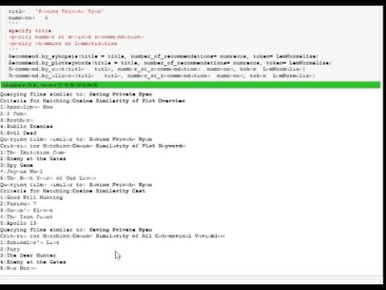
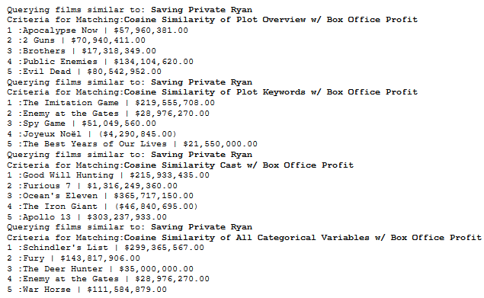
Recommendation Engines: Demos
Jake D.
Animated, No Profit Shown
Still image, Profit Shown
Let’s assume that we are the studio responsible for releasing Saving Private Ryan. We know the synopsis, the keywords that define the plot, and the cast. We want to see which movies, historically, are most similar to ours - Not only that, we want to see which made the most profit at the box office. If we find movies that are similar, we can devise a marketing plan and film rollout similar to those that proved to be successful. The most relevant films seem to be those that are closely related in all categorical measures (Synopsis + Keywords + Cast).
Seen to the left, we can note that Schindler’s List is the most related movie to Saving Private Ryan (Also the most popular of filtered results) and had the highest profit (Gross minus budget) at the box office. It would be beneficial for us to better understand the audience that saw/liked that movie and what mediums/channels to target advertising to them when creating a plan. It could also help us to roughly forecast some of the final domestic + foreign box office receipts.
Link to source code (.py file)
All code available per the below link. When running the code, a user must specify a movie title, number of recommendations, and the text cleaning (LemNormalize for Lemmatization, or StemNormalize for stemming). All functions live within a class and can be called by typing *Recommend.*. There are 4 functions within the class: by_synopsis, by_plotkeywords, by_cast, by_allcats.

Slide 17
Conclusion
It is very difficult to predict approximations of box office revenue based on numerical data in the dataset. Linear regression works well at approximating a conditional mean of our response, and the dataset had too much variance in that regard to prove viable towards the min and max range of the box office performance. Our model was also irregularly influenced by a movie’s budget because of the natural, linear nature between spending more on a film resulting in a larger audience turnout.
A logistic model centered around profitability worked well at predicting whether or not a movie will gross more than 2mm above its box office budget or not. This worked when dealing with incomplete information at a rate of 73%. The way we modeled this using sparse matrices also allows us to see subsets of features and would help us model the tradeoff of resulting utilities if we wanted to talk about which actor/director combinations were more likely to lead to box office profitability.
The recommendation engine helps us to understand a prospective movie against past movies and get a better idea of what movies that had similar keywords/genres/actors/directors/plots performed well at the box office. This is useful in the planning stages of production - On the previous slide we looked at Saving Private Ryan. Schindler’s list was noted as the most similar movie, based on all of the features fed into the nearest-neighbors approach, that enjoyed a high level of success at the box office. As such, we could reason that the audience that saw Schindler’s list en masse is the same audience that we should target our advertising and marketing efforts towards in order to maximize ROI.

Slide 18
References
Links to Internal Project Checkpoints:
Checkpoint 1: https://docs.google.com/document/d/1fkQ99FnrIxXErQ3iaxN2M6WU7Hf4248VdZ00Ingz8os/edit
Checkpoint 2: https://docs.google.com/document/d/1_BshAAUeNSR36Ox0WawTPS71bKxnD4icSrx0Z4N5EJs/edit
External Sources
https://help.imdb.com/article/imdb/track-movies-tv/faq-for-imdb-ratings/G67Y87TFYYP6TWAV#
https://www.kaggle.com/fabiendaniel/film-recommendation-engine/comments
https://www.techemergence.com/use-cases-recommendation-systems/
https://sites.temple.edu/tudsc/2017/03/30/measuring-similarity-between-texts-in-python/

